Slide 1

The Future of Client Management
Greg Jensen
Senior Director Management & Security
Microsoft Corporation

Slide 2


Windows 7 Delivers Lower TCO
Delivering on the Promise to Reduce Your IT Costs
Basic
Standardized
Rationalized
$1,320/PC
$542/PC
$261/PC
$1,171/PC
$483/PC
$228/PC

Slide 3




Centralized Power Management
Performance and Scale Enhancements
Mobile Device Management
Foundation for Forefront Endpoint Protection
City of Helsinki
MSIT Savings
Estimates saving over €285,000 per year in electricity costs (20,000 desktops)
With move to Windows 7, 30% additional savings anticipated
27 percent drop in the power used by managed machines
Projected savings of $460,000 this fiscal year

Slide 4
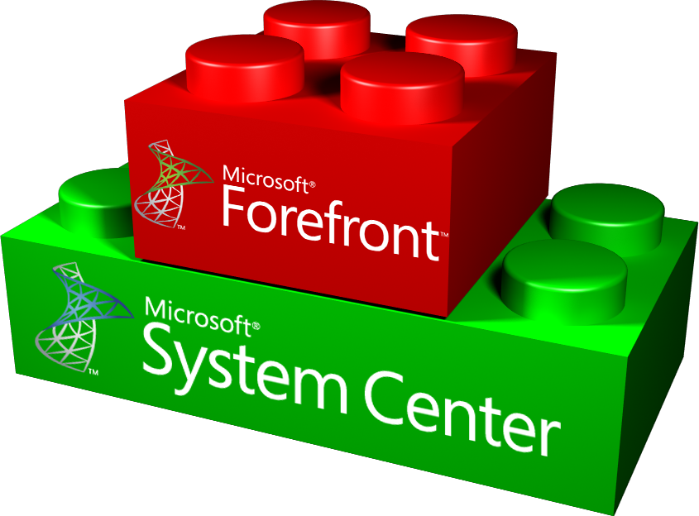
Protect and Manage Against Threats One infrastructure for desktop management and protection
Provides one familiar experience for desktop management and protection
Minimizes cost and complexity by using existing infrastructure
Improved visibility to help identify and remediate potentially vulnerable endpoints
Slovenia Telecom
“The deployment process for Forefront Endpoint Protection was very simple….FEP was so intuitive that we were able to move much more quickly than anticipated.”

Slide 5

Converging Security and Management
Adwait Joshi (AJ)
demo

Slide 6



The Changing Face of Client Management
DESKTOP
RISE OF THE LAPTOP
ENTER MOBILITY
Corporate-Owned Desktop
Rich Corporate Laptop
User-Driven Device Choices
Connected to Corp Network
Productive Online or Offline
Cloud Connected
Management Sets Standards
Management Limits Risk
Management Enables Experience

Slide 7

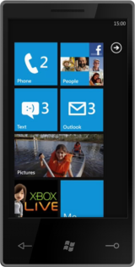



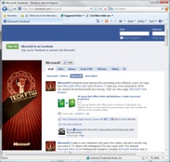
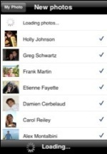



Fundamental IT Transformation Driven by Mobility and Consumerization
End users expect Monday morning’s technology experience
to be the same as
that experienced on Sunday evening!

Slide 8

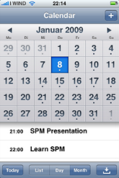

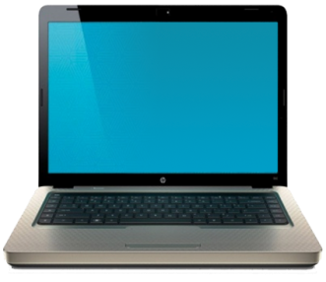
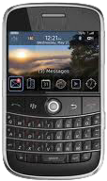
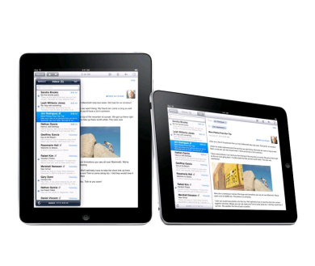
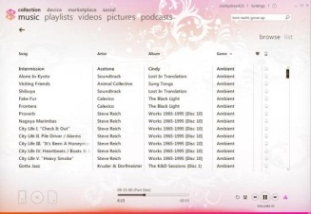

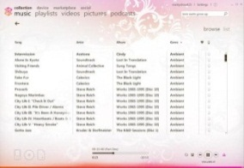


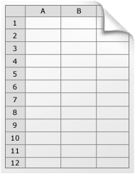
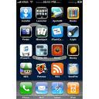


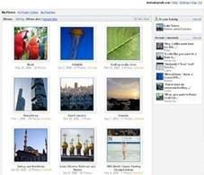

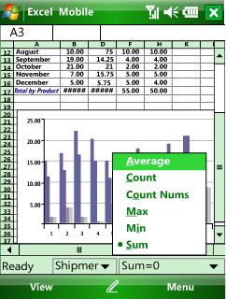


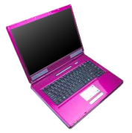
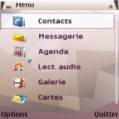

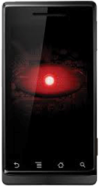
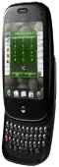

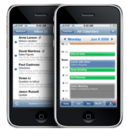



But I Still Need to…
…help maximize end-user productivity
…reduce the cost of supporting end-users
…ensure corp data and resources are protected and secure
IT

Slide 9

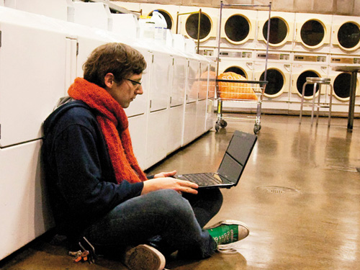








User-centric approach to empowering people with secure, compliant access to computing resources – from anywhere, on the devices they choose.

Slide 10





Route to User-Centricity A comprehensive client strategy is required
Anywhere Access for Users
End-to-End Management
Secure and Compliant
Provides a Route to the Cloud

Slide 11
User-Centric Management
demo

Slide 12


System Center Service Manager
Consistent Process
“Equiniti has a phenomenal appetite for change, and System Center Service Manager will enable us to manage that change without disrupting our users’ world.”
“I expect…”
“I still need to…”
A flexible platform for automating and adapting IT Service Management best practices
Provides built-in processes based on industry best practices for incident and problem resolution, and change control
Powerful integration across the Microsoft platform

Slide 13


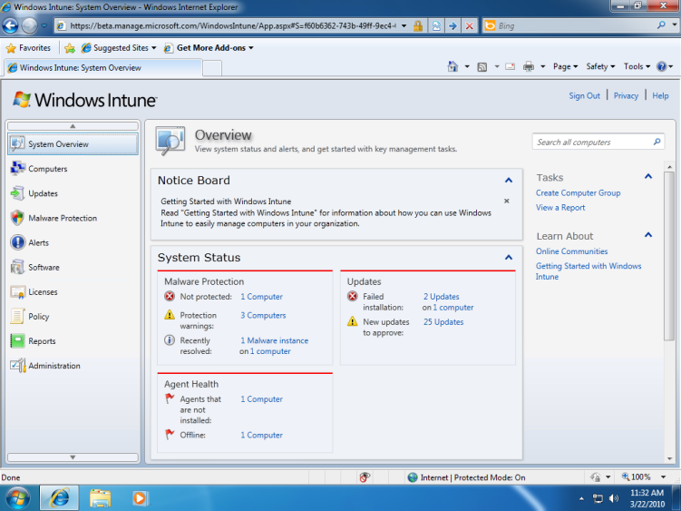
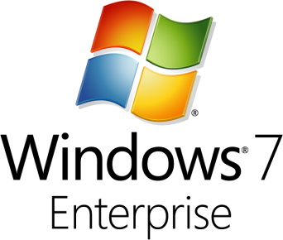
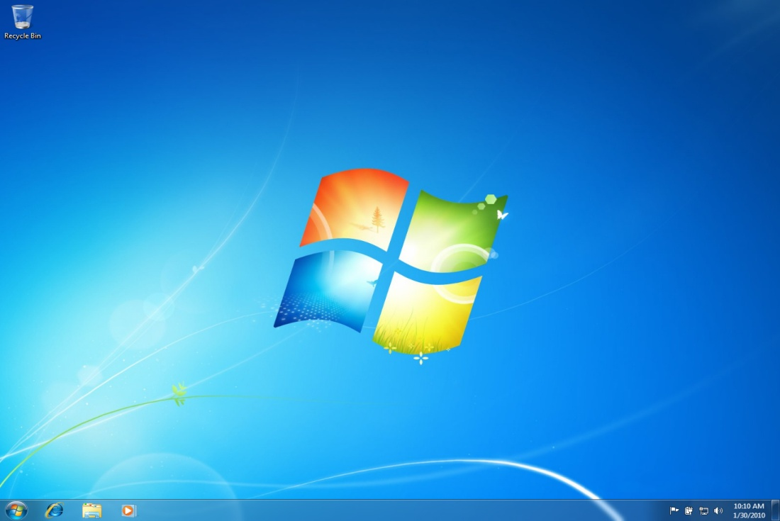
Manage and secure PCs with simple, Web-based administration console
Inventory Hardware and Software
Manage updates
Proactively monitor PCs
Provide remote assistance
Protect PCs from malware
Set security policies
Gives customers the best Windows experience
Windows 7 Enterprise license rights included

Slide 14


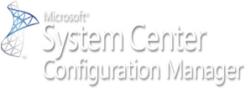







Microsoft Client Manageability Roadmap
2009
2010
2011
2007 R2
2012
2008 R2
2012
2007 SP2
R3
2012
2010
2010
R2
2009 & R2
2010 & R2
2011 & R2
V1
2010
2010
Notes:
14
© 2008 Microsoft Corporation. All rights reserved. Microsoft, Windows, Windows Vista and other product names are or may be registered trademarks and/or trademarks in the U.S. and/or other countries.
The information herein is for informational purposes only and represents the current view of Microsoft Corporation as of the date of this presentation. Because Microsoft must respond to changing market conditions, it should not be interpreted to be a commitment on the part of Microsoft, and Microsoft cannot guarantee the accuracy of any information provided after the date of this presentation. MICROSOFT MAKES NO WARRANTIES, EXPRESS, IMPLIED OR STATUTORY, AS TO THE INFORMATION IN THIS PRESENTATION.

Slide 15

© 2010 Microsoft Corporation. All rights reserved. Microsoft, Windows, Windows Vista and other product names are or may be registered trademarks and/or trademarks in the U.S. and/or other countries.
The information herein is for informational purposes only and represents the current view of Microsoft Corporation as of the date of this presentation. Because Microsoft must respond to changing market conditions, it should not be interpreted to be a commitment on the part of Microsoft, and Microsoft cannot guarantee the accuracy of any information provided after the date of this presentation. MICROSOFT MAKES NO WARRANTIES, EXPRESS, IMPLIED OR STATUTORY, AS TO THE INFORMATION IN THIS PRESENTATION.

